Slide 1
JOURNEY SCRAPBOOK
FOUNDATIONAL TRAINING
12-09-2023 to 15-09-2023
Purushottam Behera

Slide 2
Agenda week-4
Azure Synapse Analytics
Power AI
Python

Slide 3
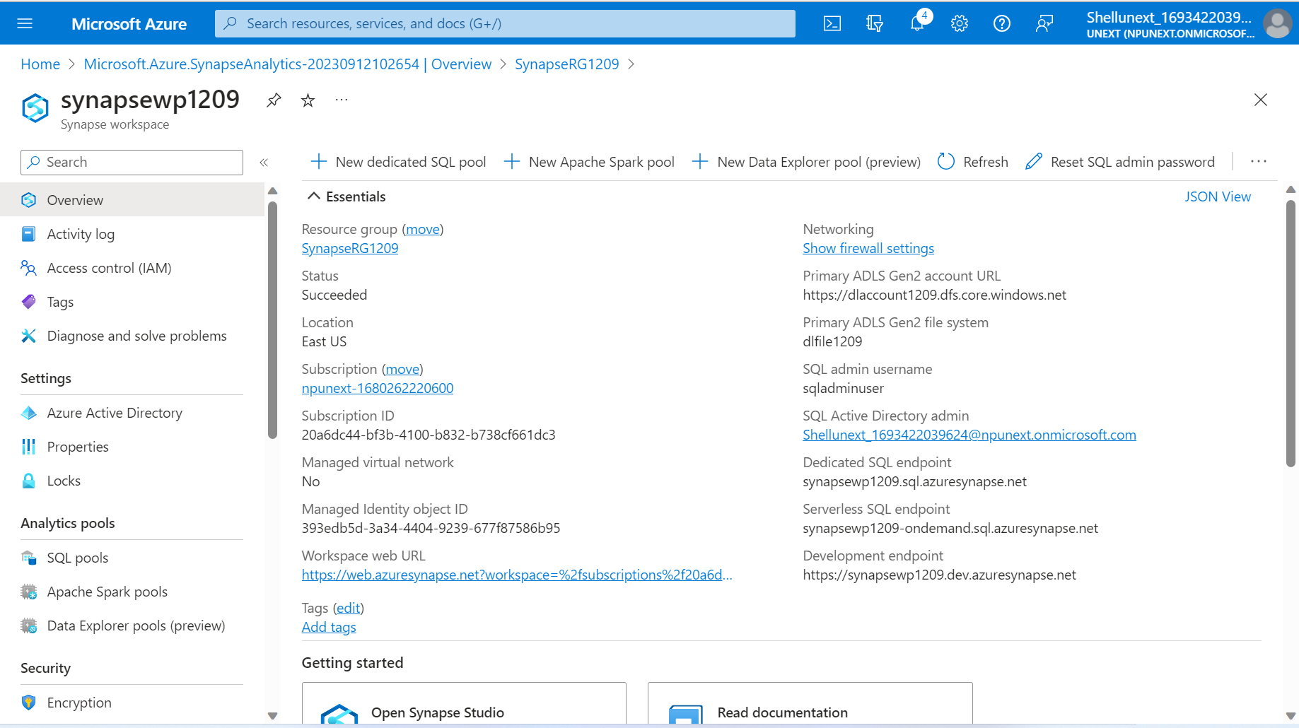
Day – 1 (Azure Synapse Analytics)

Slide 4
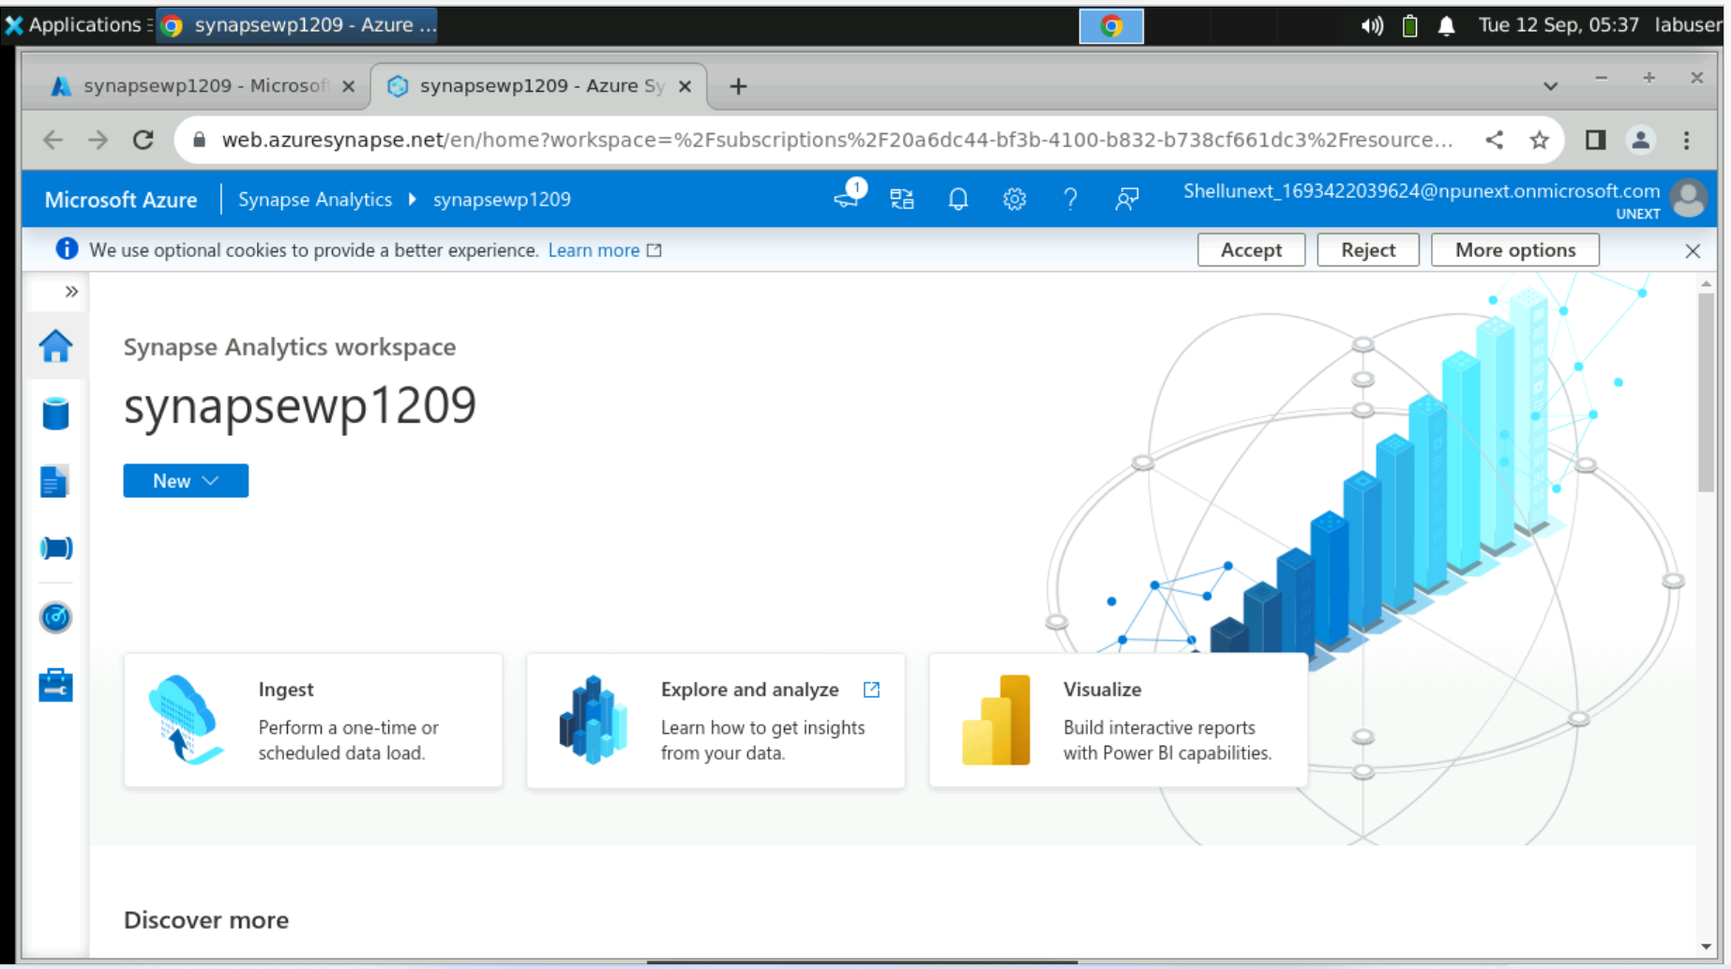
Day – 1 ( Continued… )

Slide 5
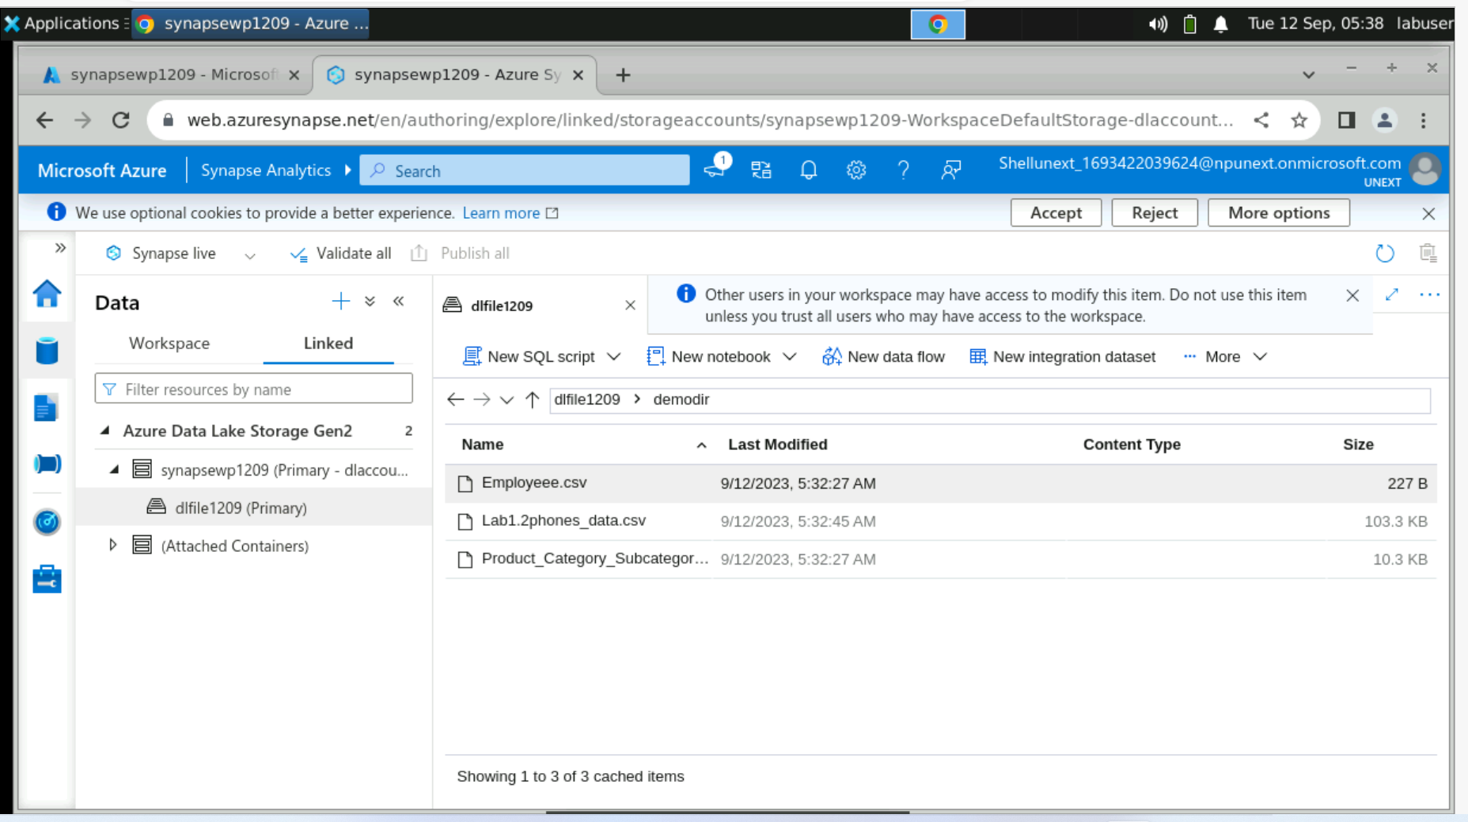
Day – 1 ( continued… )

Slide 6
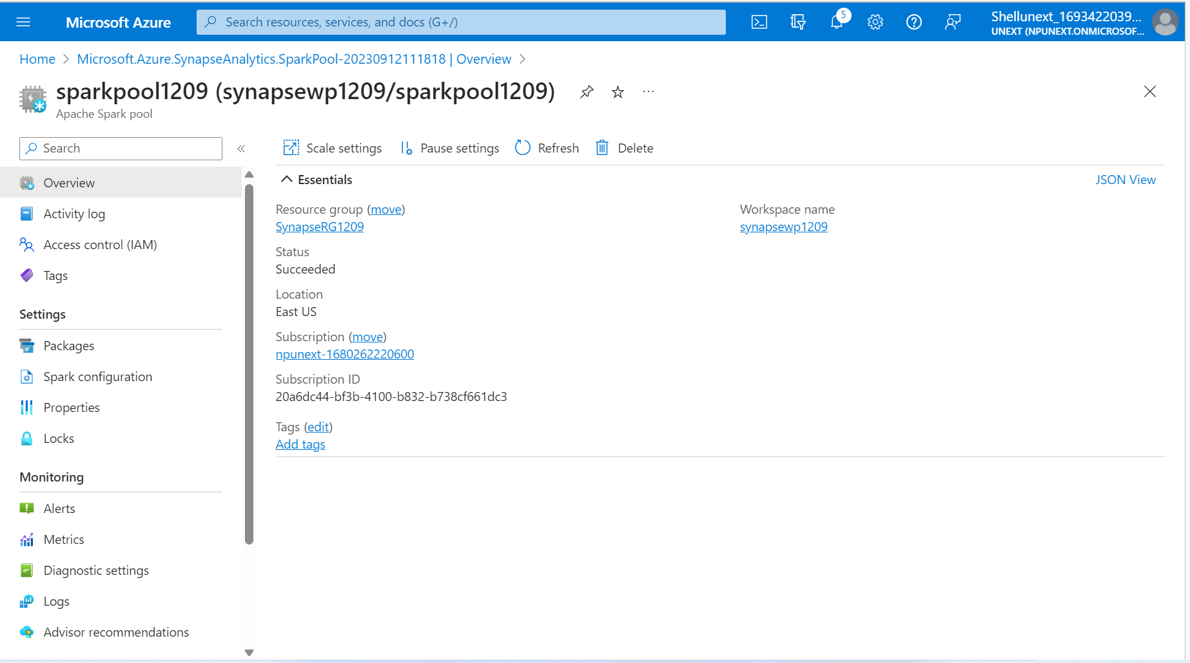
Day – 1 ( continued… )

Slide 7
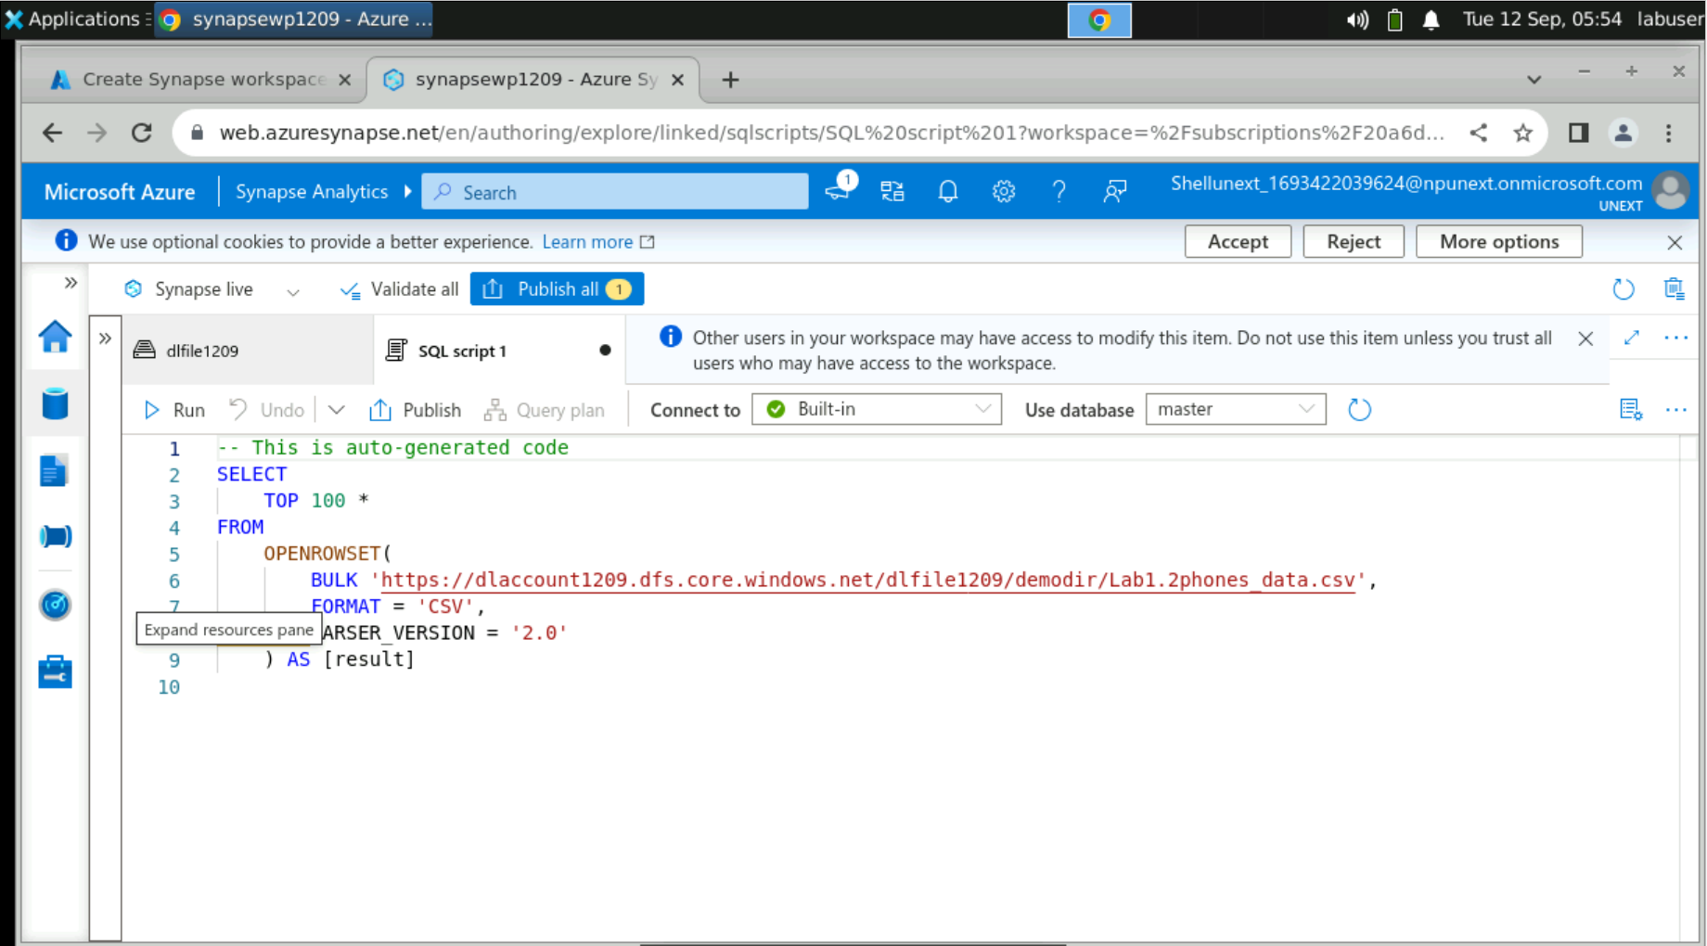
Day – 1 ( continued… )

Slide 8
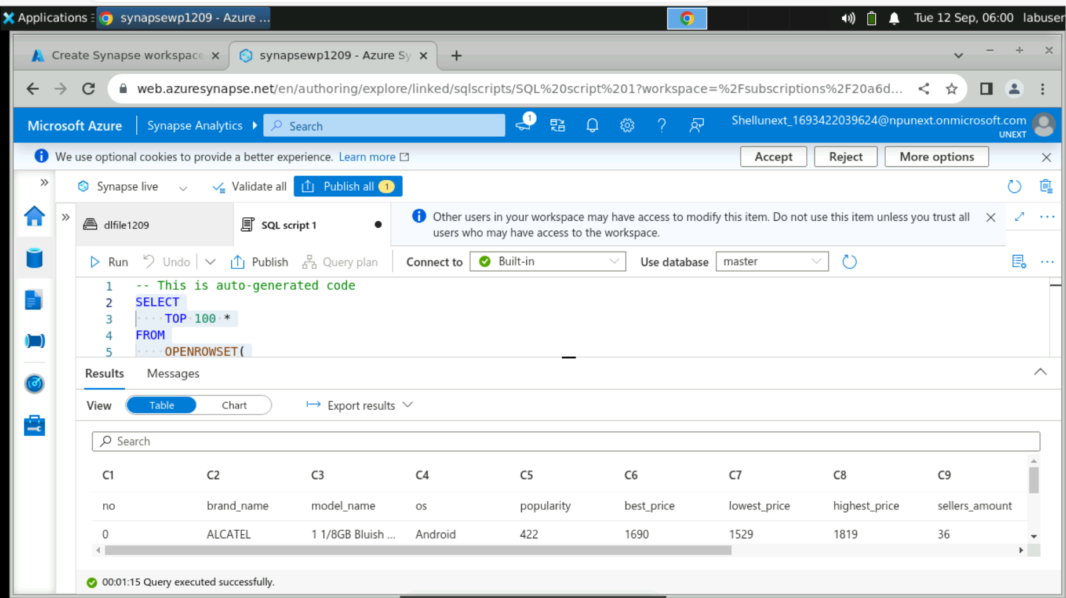
Day-1 (continued…)

Slide 9
Day – 1 ( continued… )

Slide 10
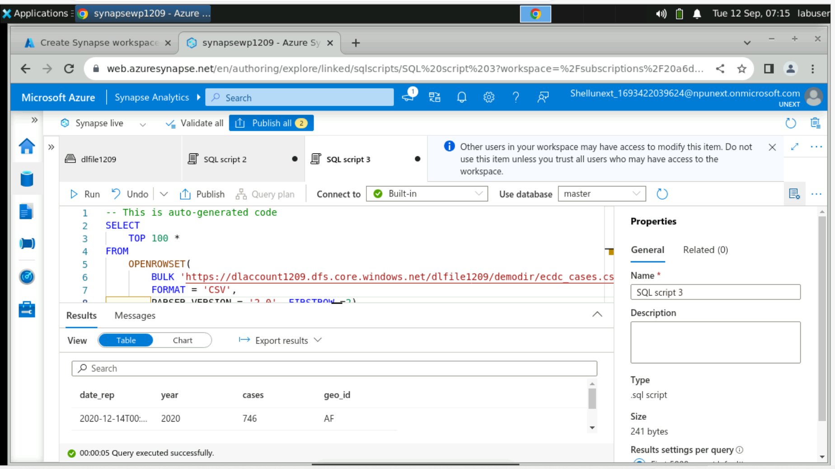
Day – 1 ( continued… )

Slide 11
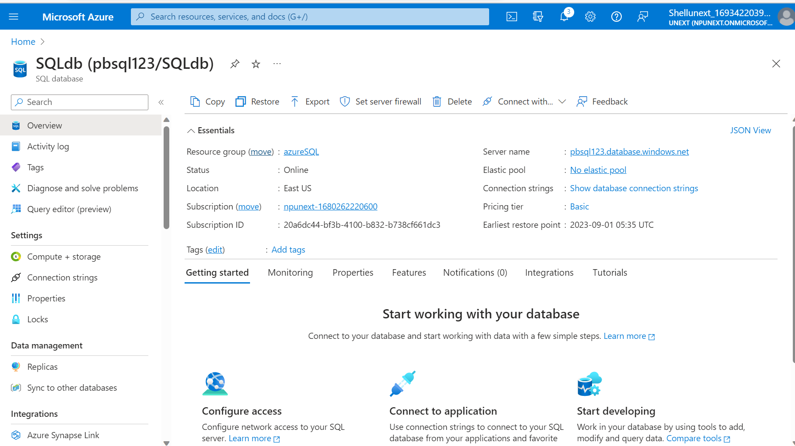
Day-1 ( continued…)

Slide 12
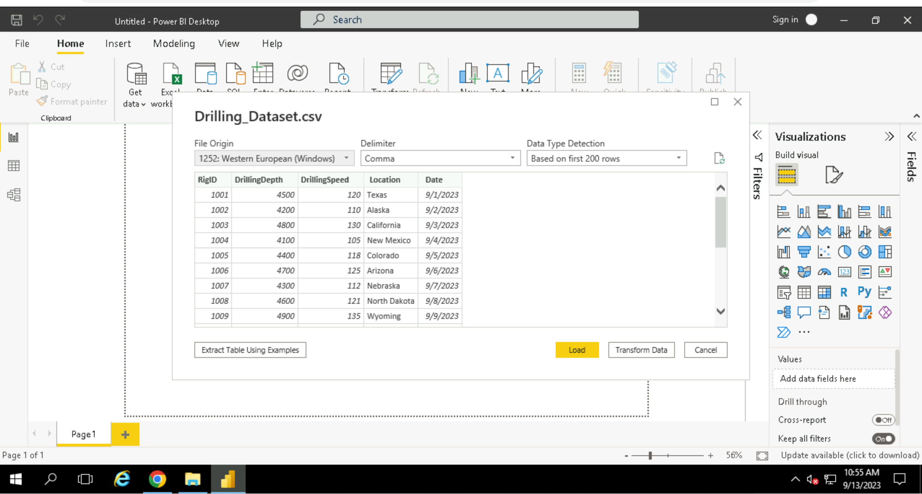
Day-2 (Power BI)

Slide 13
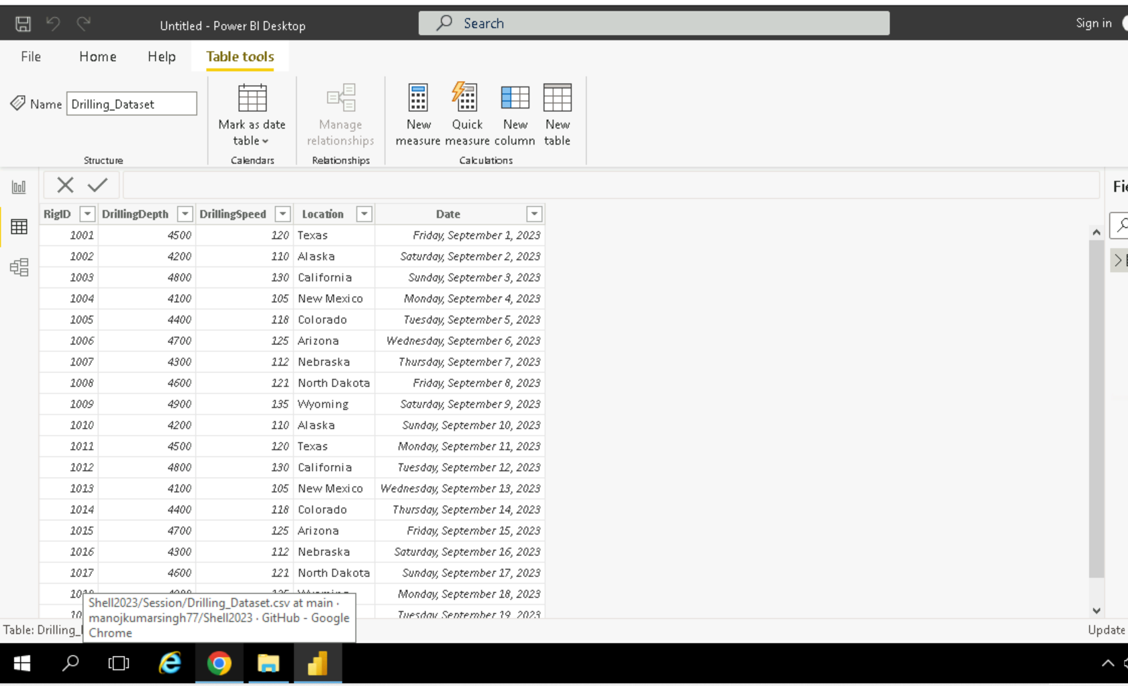
Day-2 ( continued…)

Slide 14
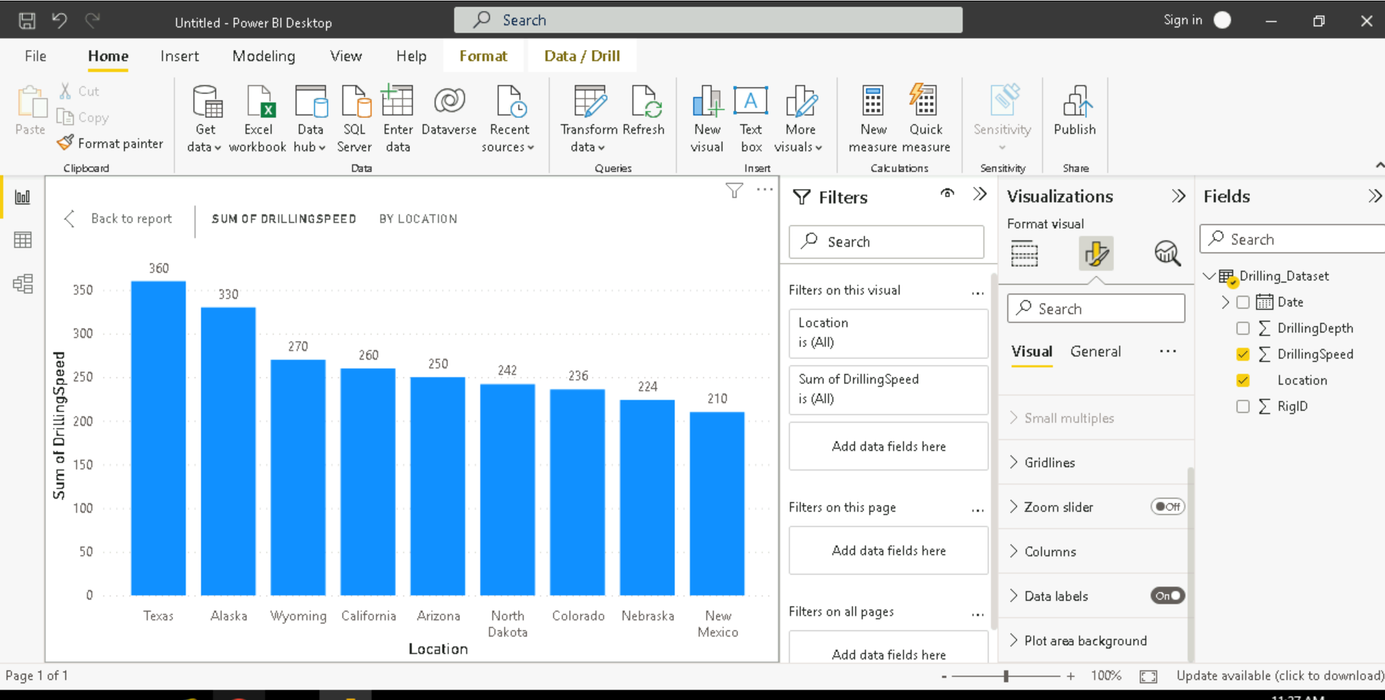
Day-2 ( continued…)

Slide 15
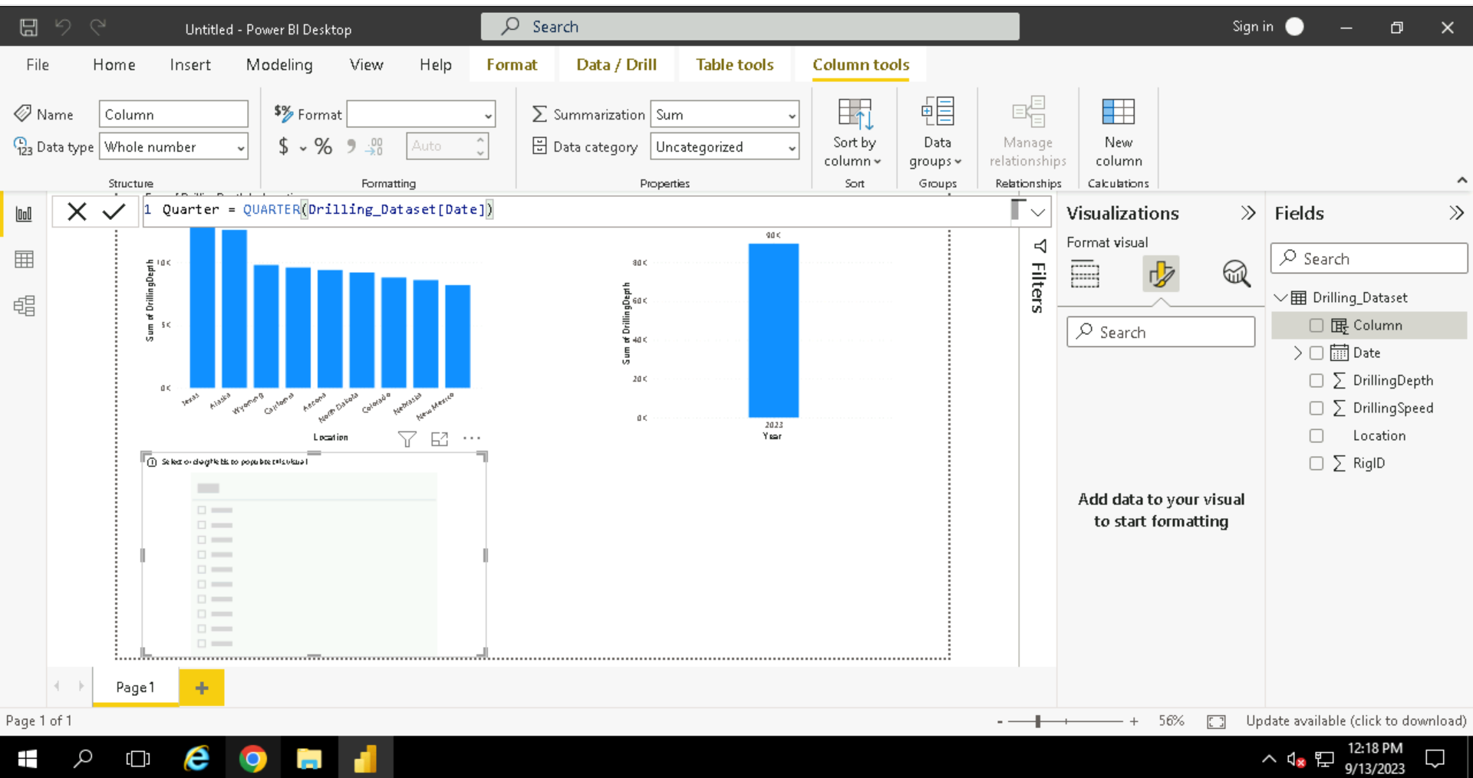
Day-2 ( continued…)

Slide 16
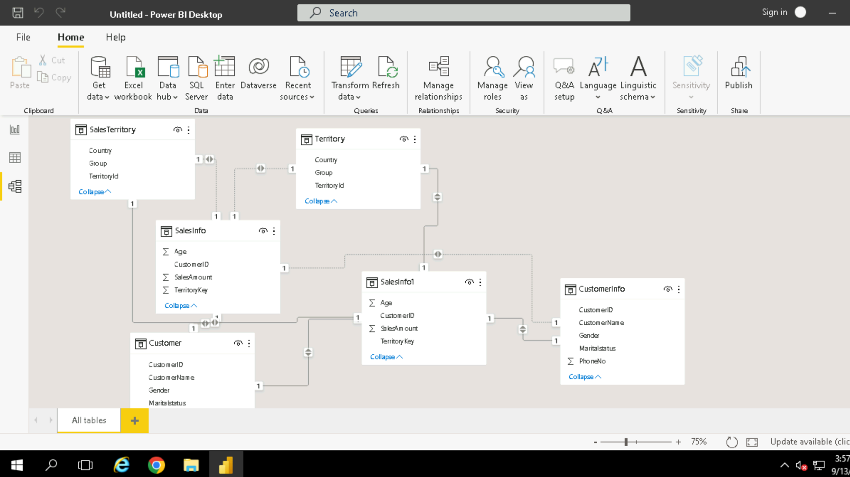
Day-2 ( continued…)

Slide 17
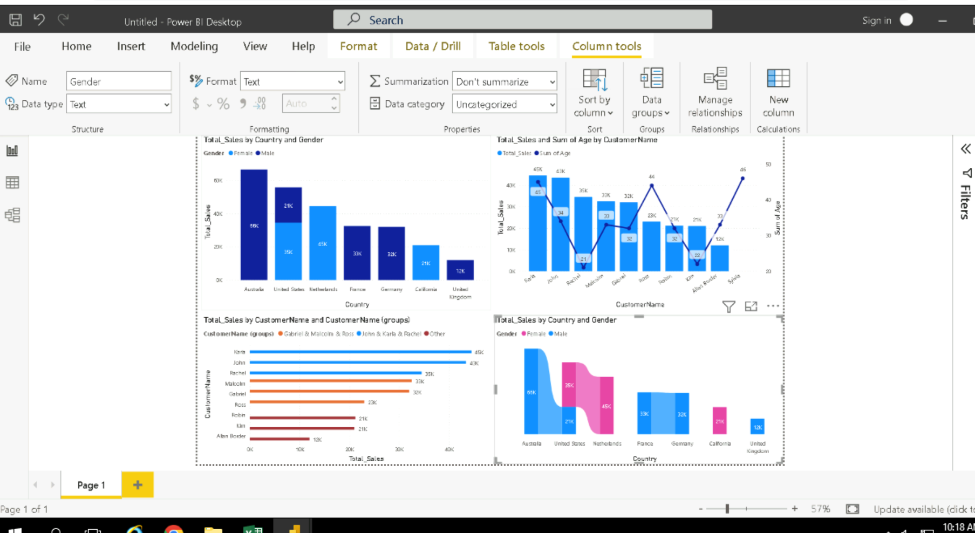
Day-2 ( continued…)

Slide 18
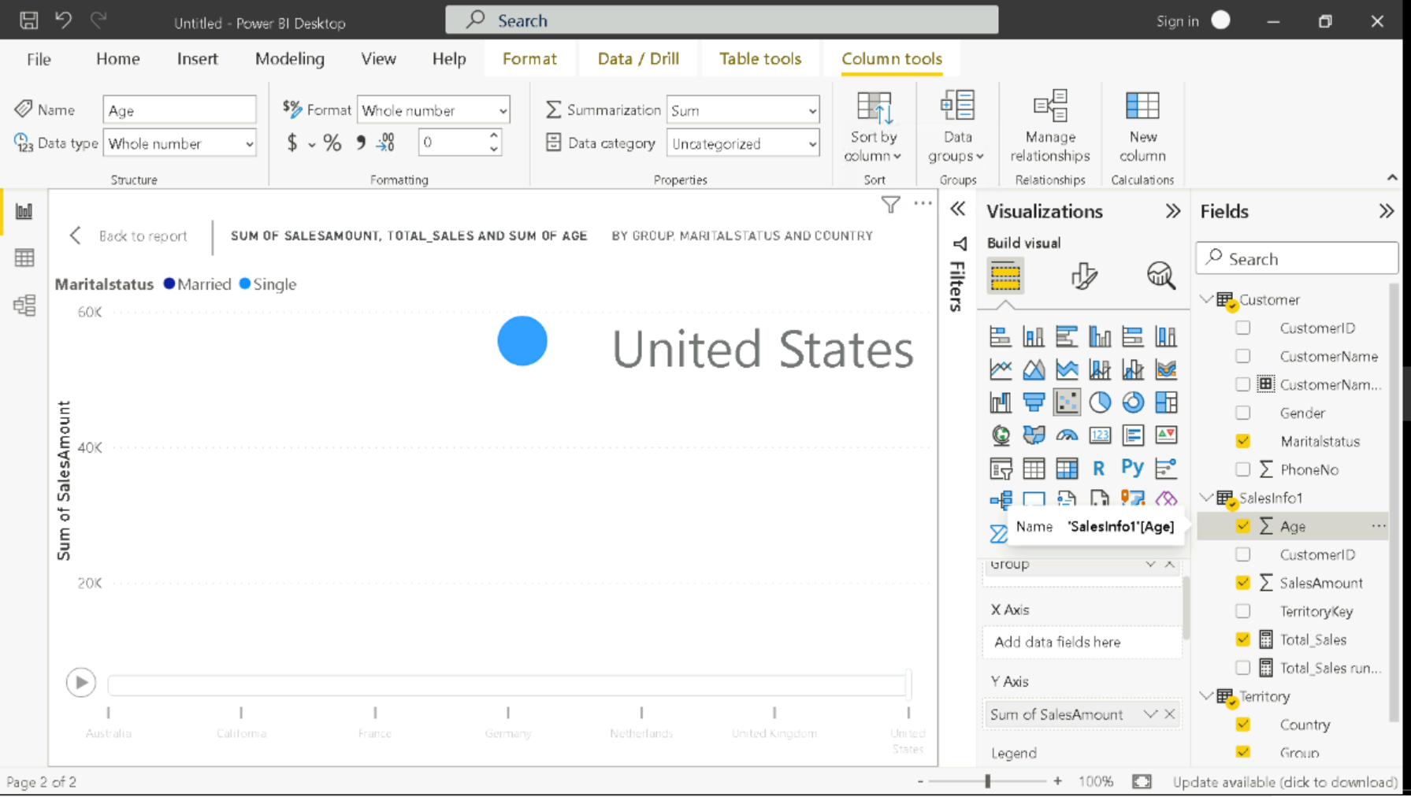
Day-2 ( continued…)

Slide 19
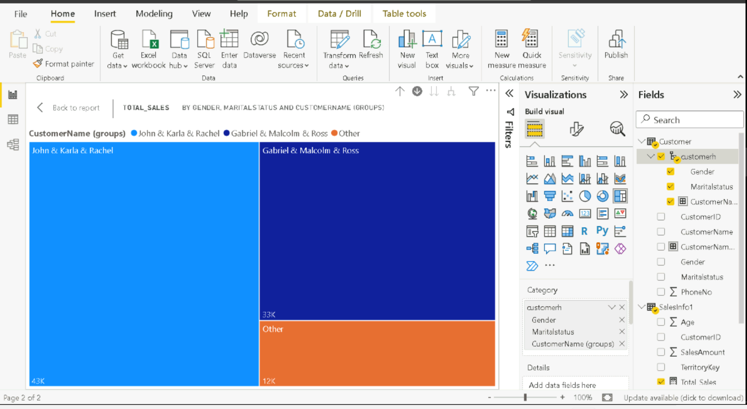
Day-2 ( continued…)

Slide 20
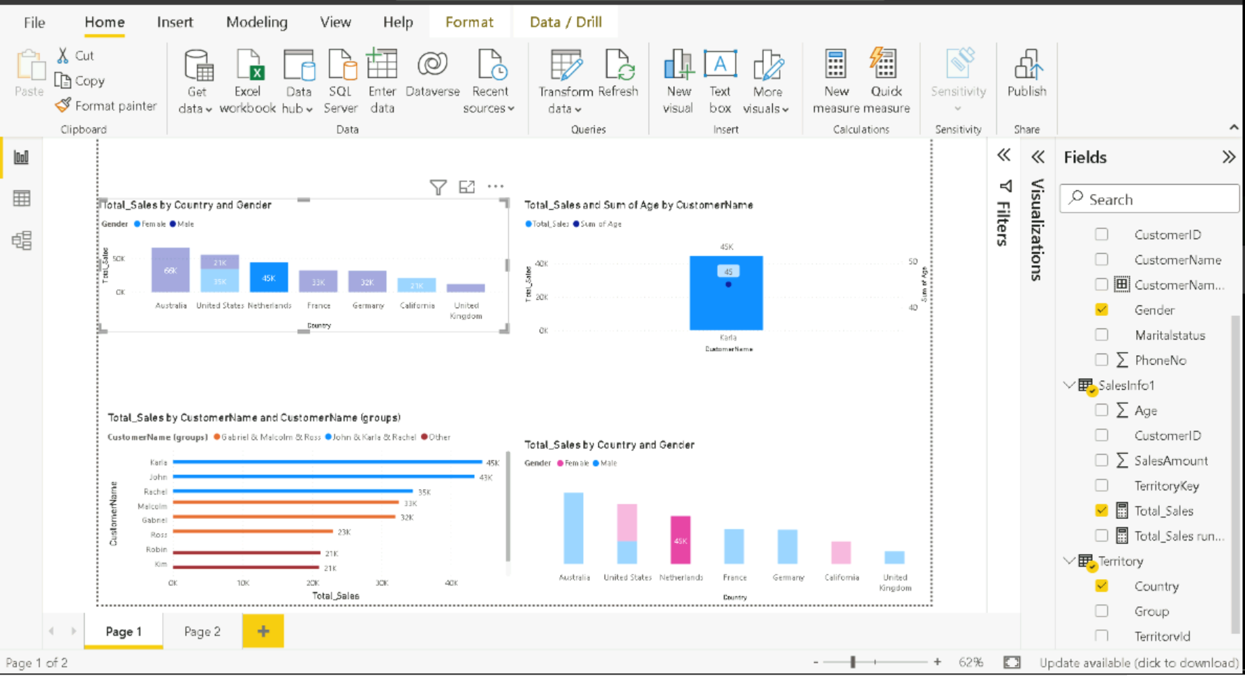
Day-2 ( continued…)

Slide 21
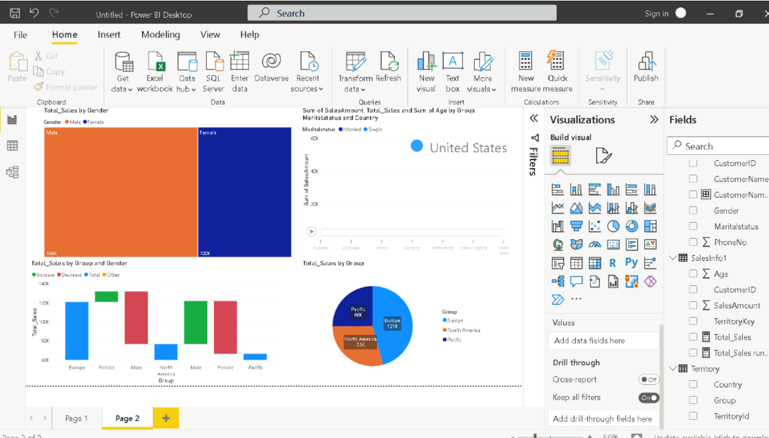
Day-2 ( continued…)

Slide 22
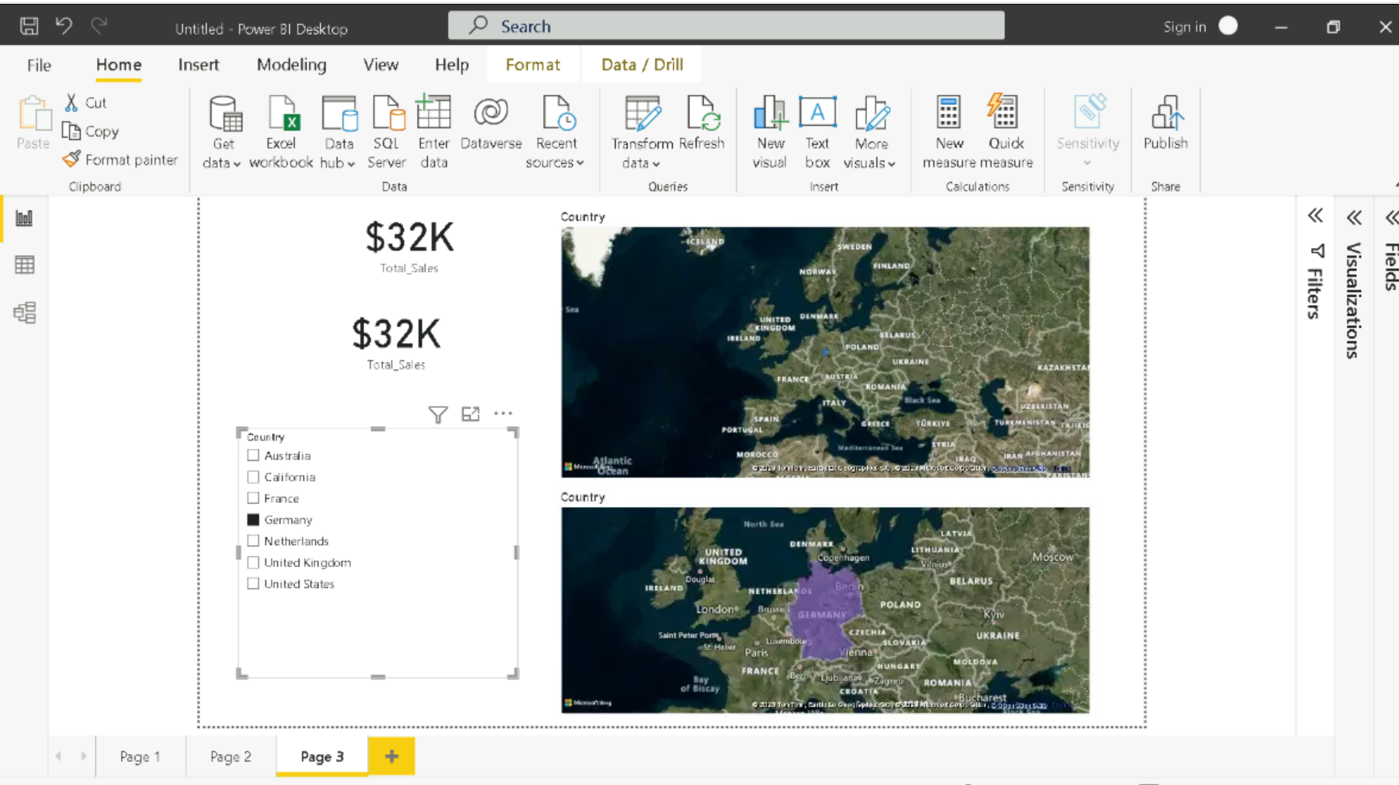
Day-2 ( continued…)

Slide 23
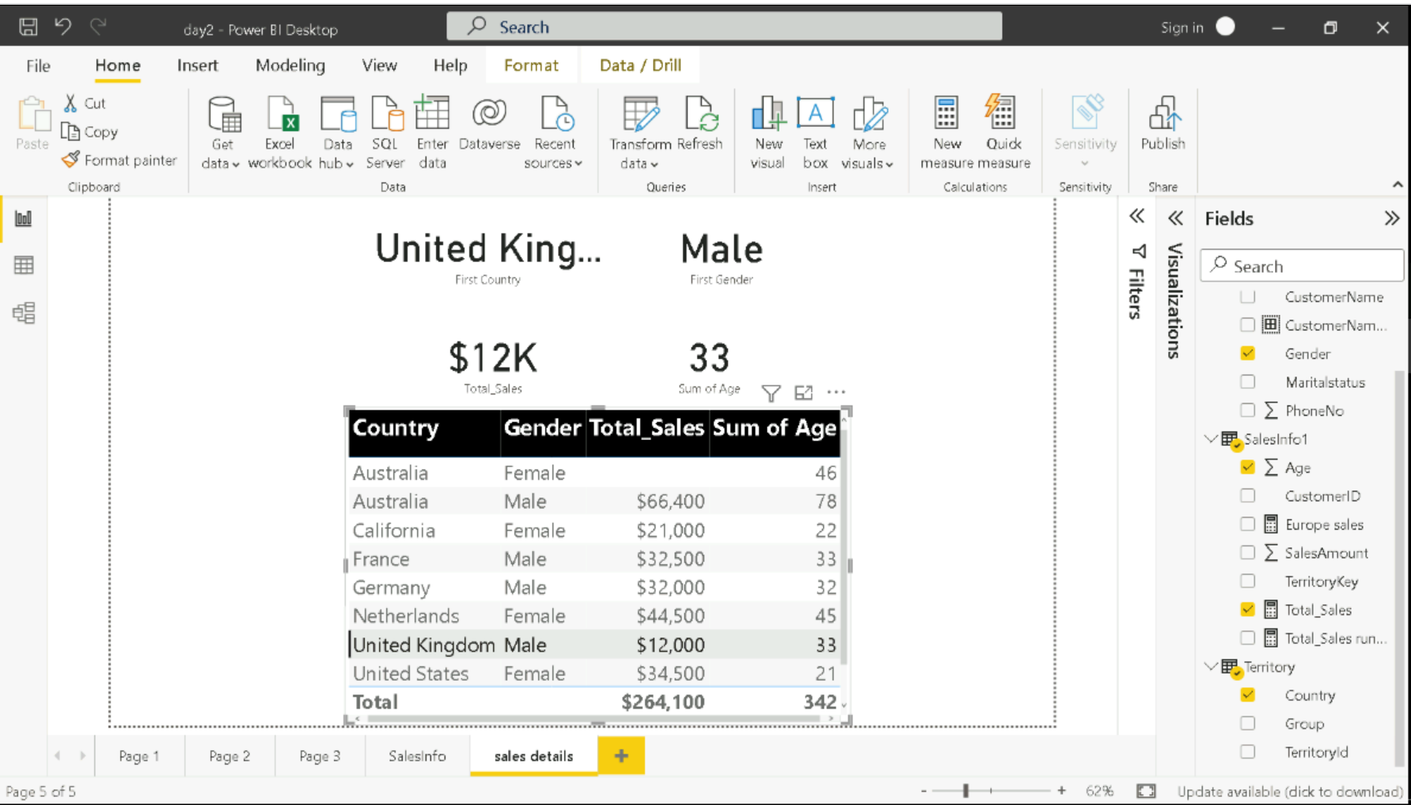
Day-2 ( continued…)

Slide 24
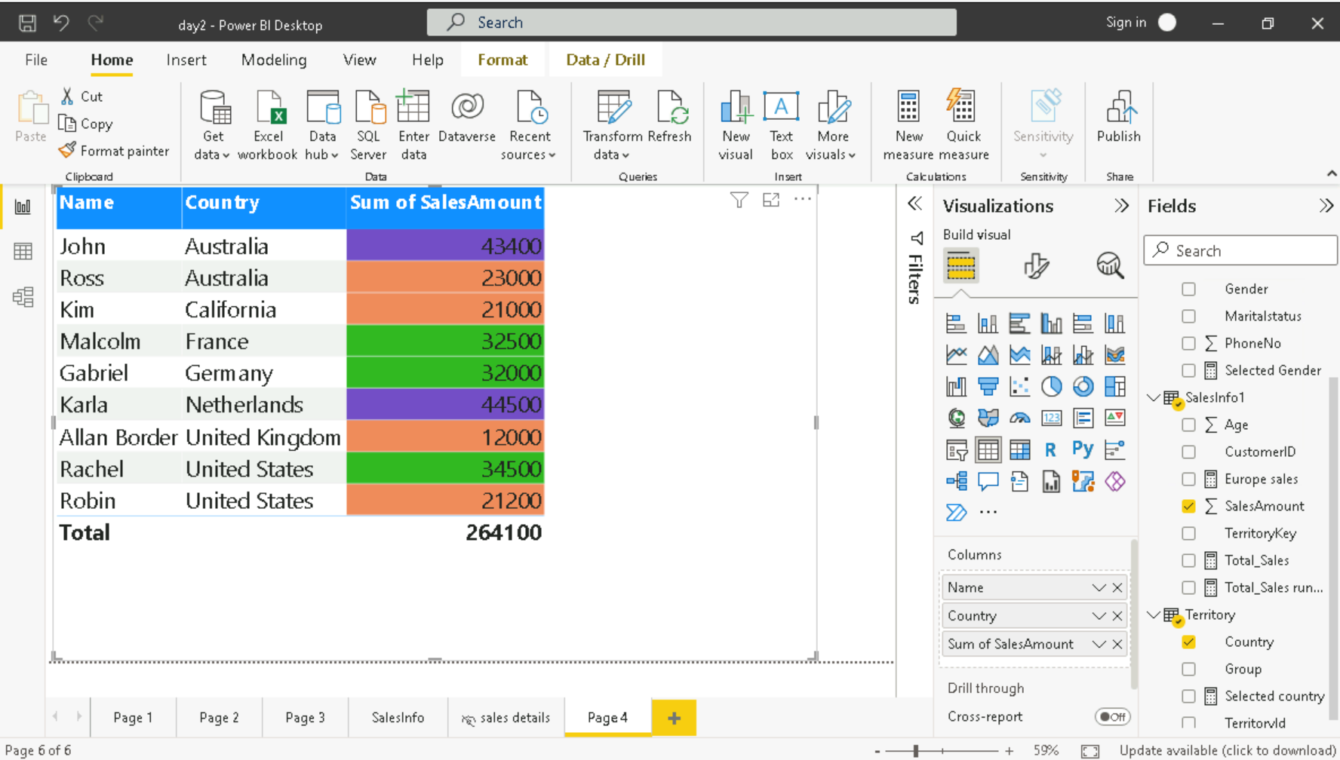
Day-2 ( continued…)

Slide 25
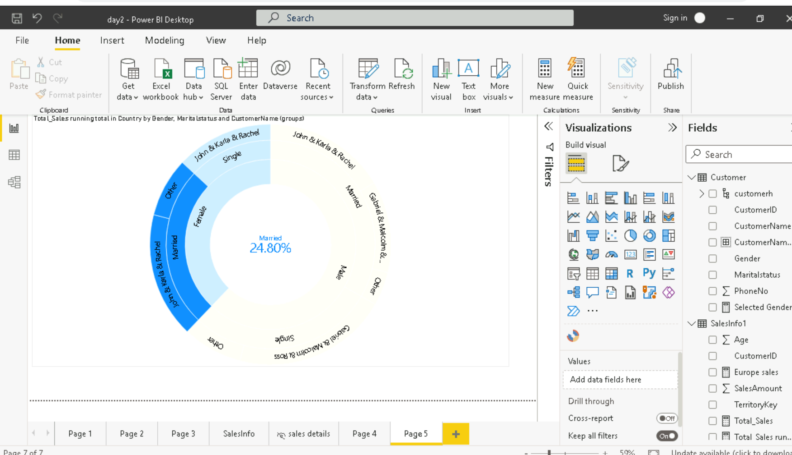
Day-2 ( continued…)

Slide 26
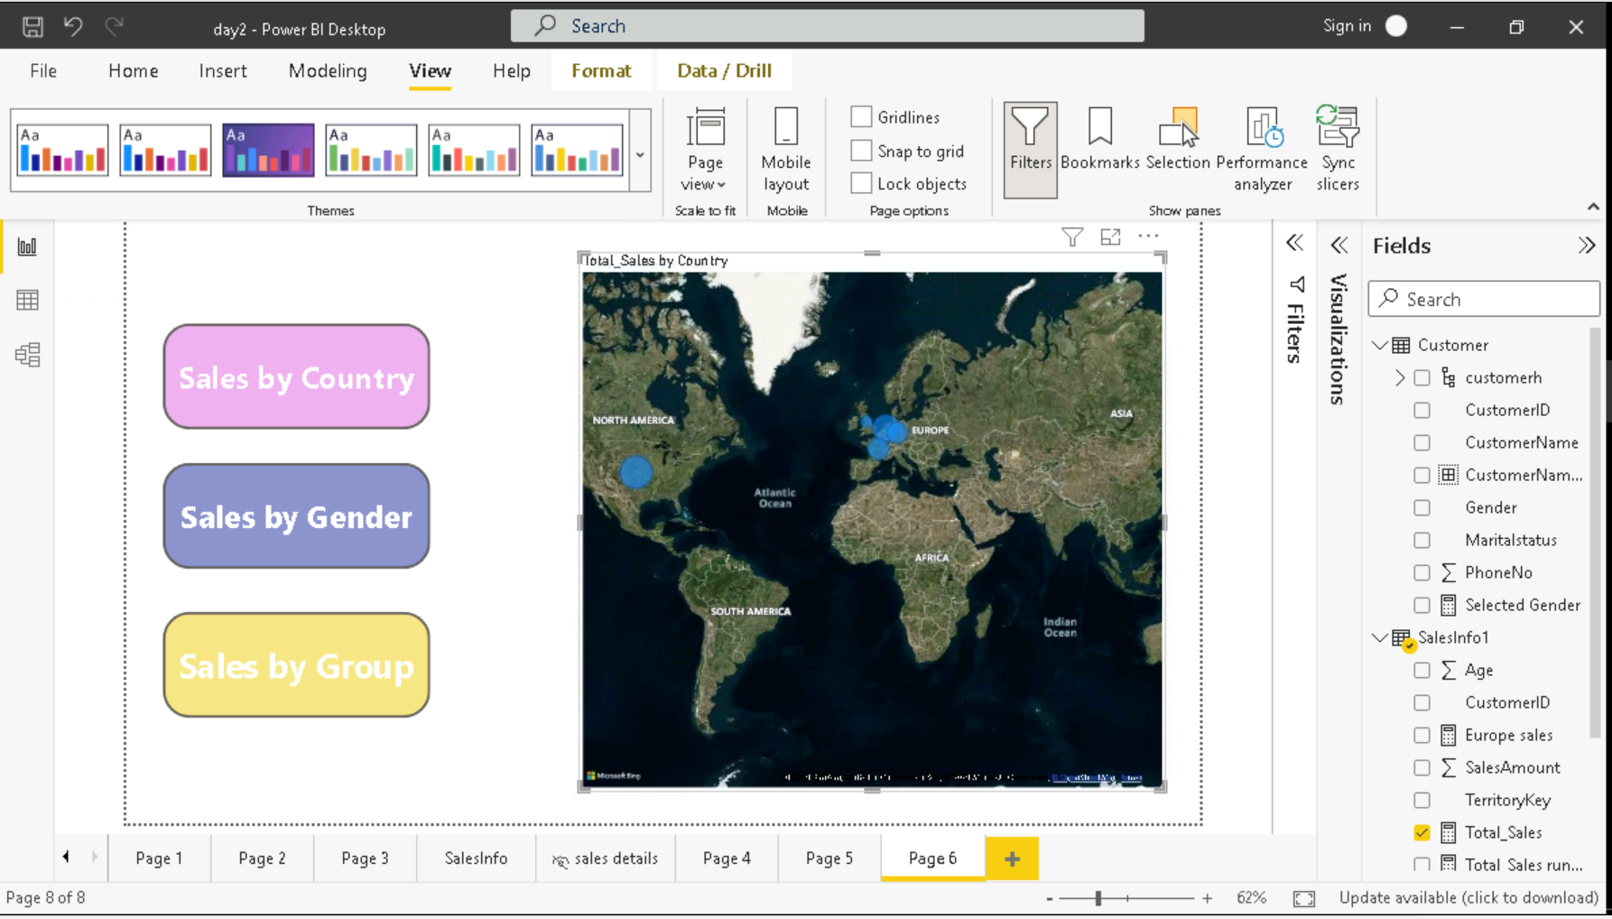
Day-2 ( continued…)

Slide 27
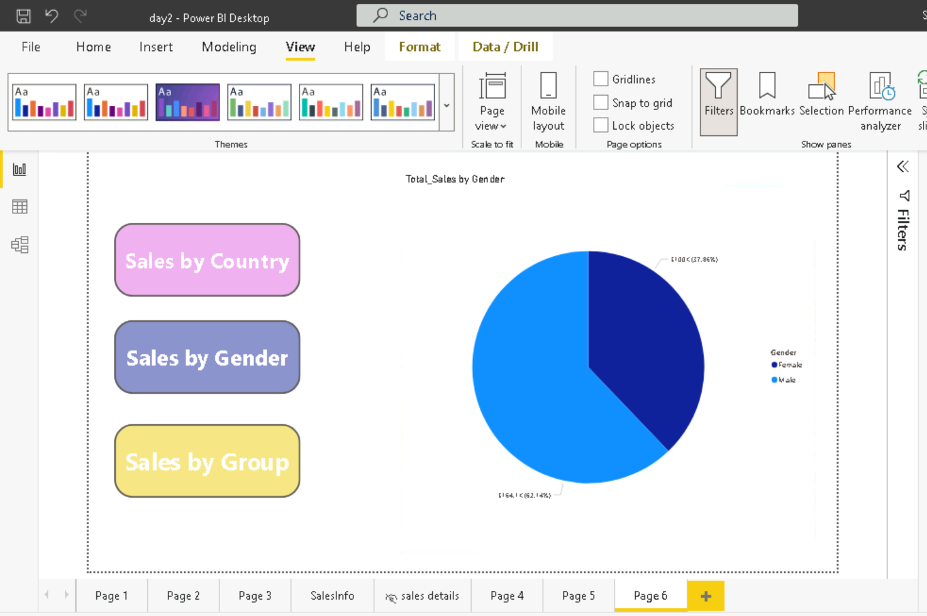
Day-2 ( continued…)

Slide 28
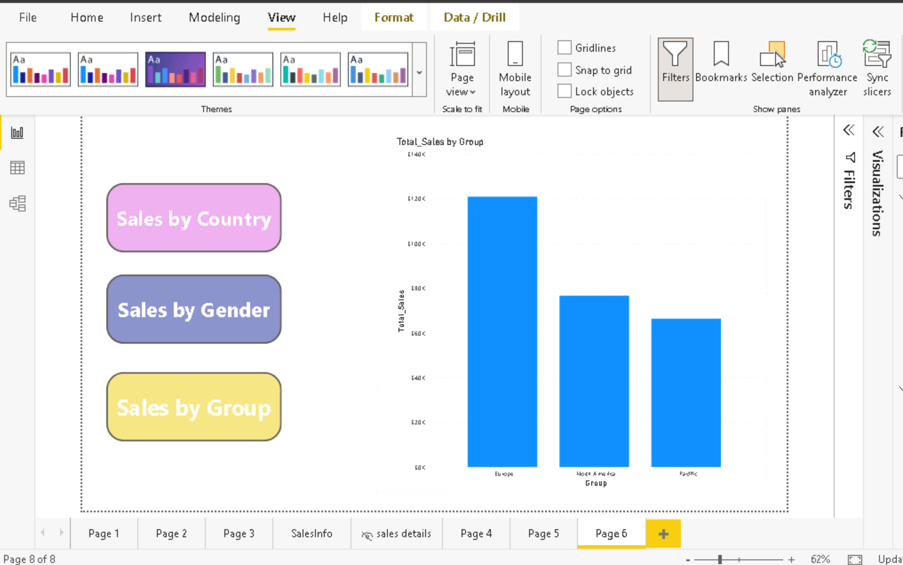
Day-2 ( continued…)

Slide 29
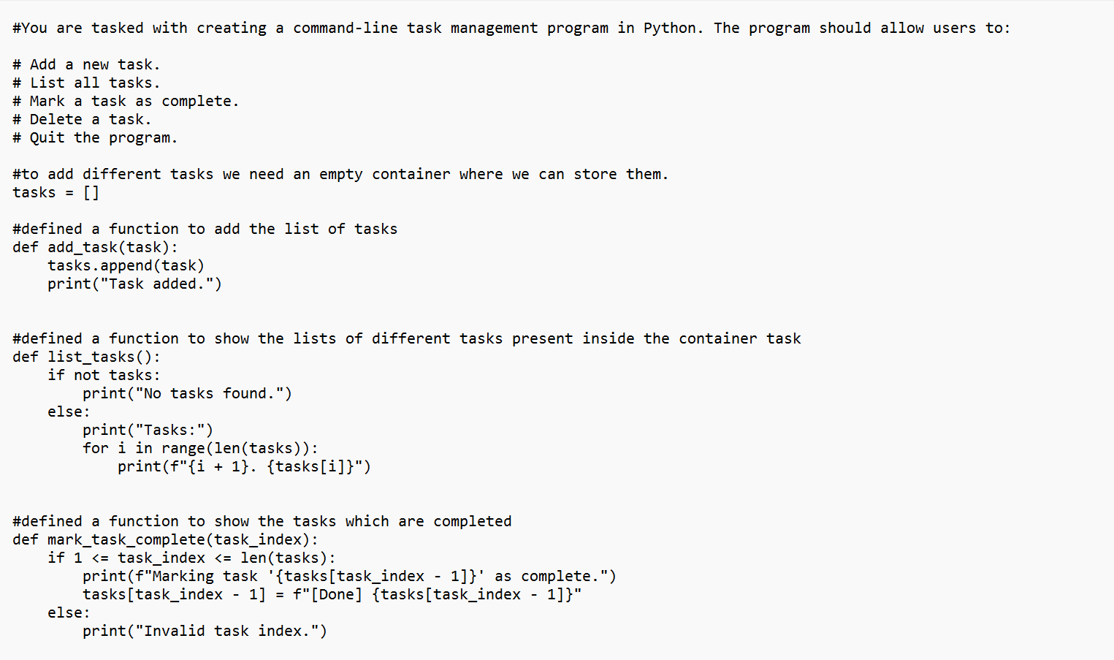
Day-3 (Python)

Slide 30
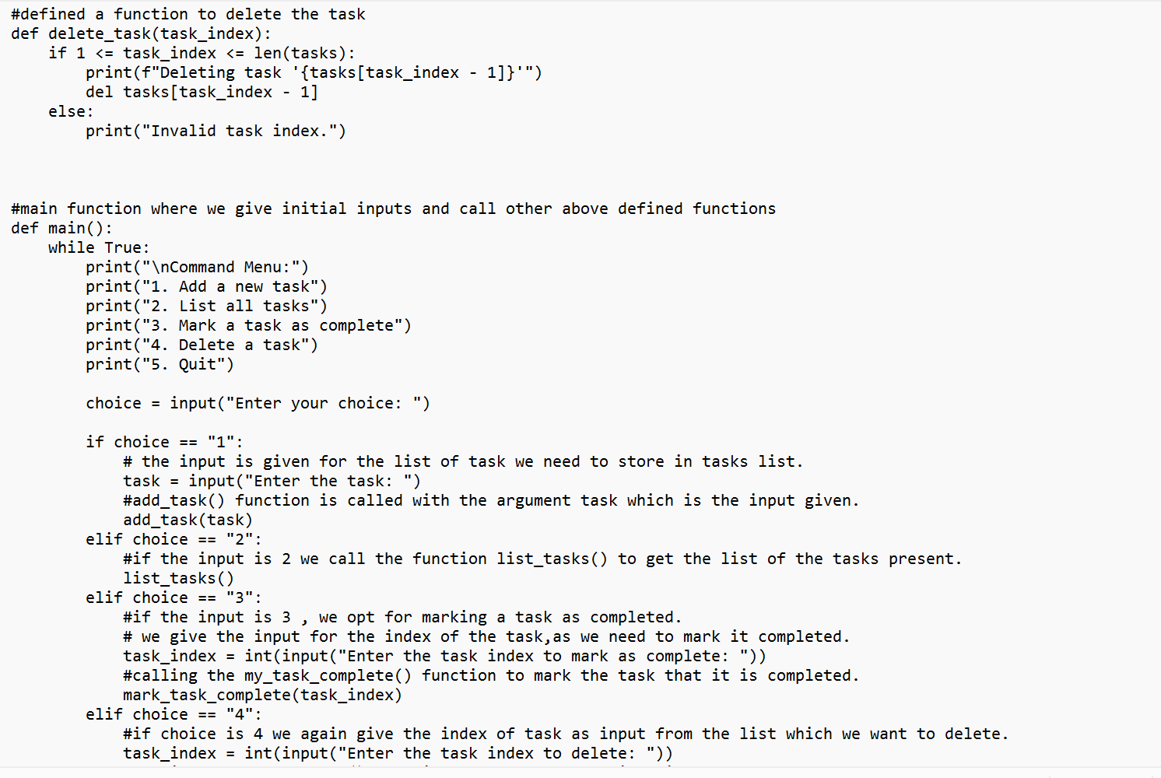
Day-3 ( continued…)

Slide 31
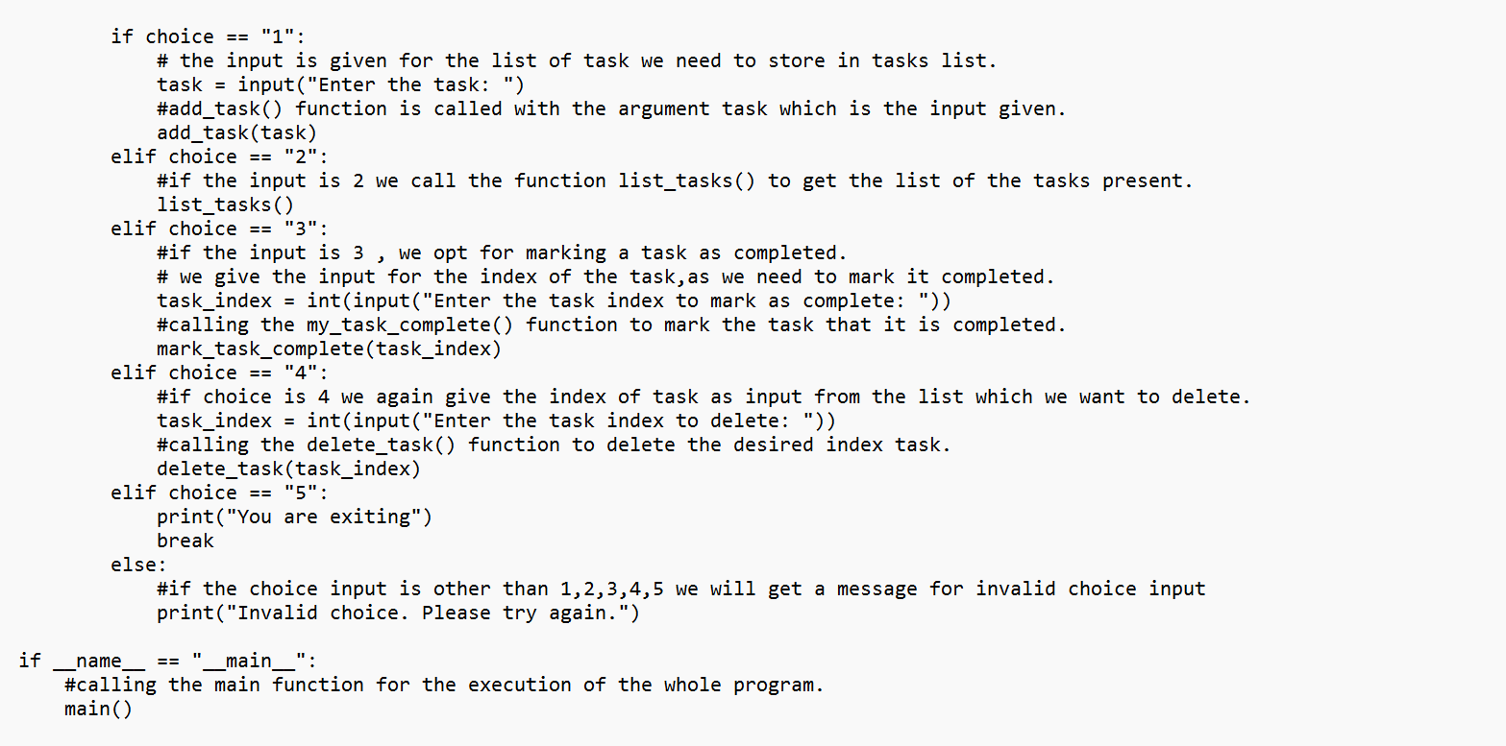
Day-3 ( continued…)

